Slide 1
Practice Makes Permanent
Barbara Oakley, PhD, PE

Slide 2
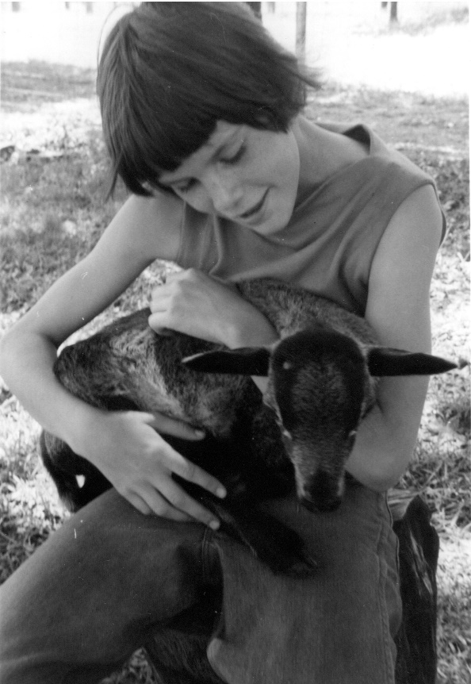

Slide 3
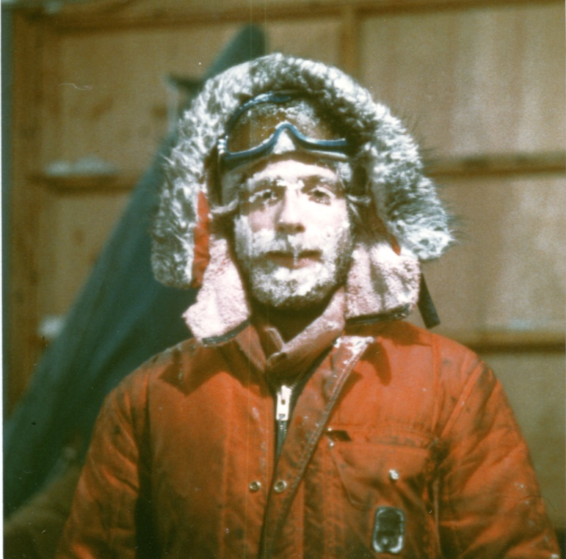
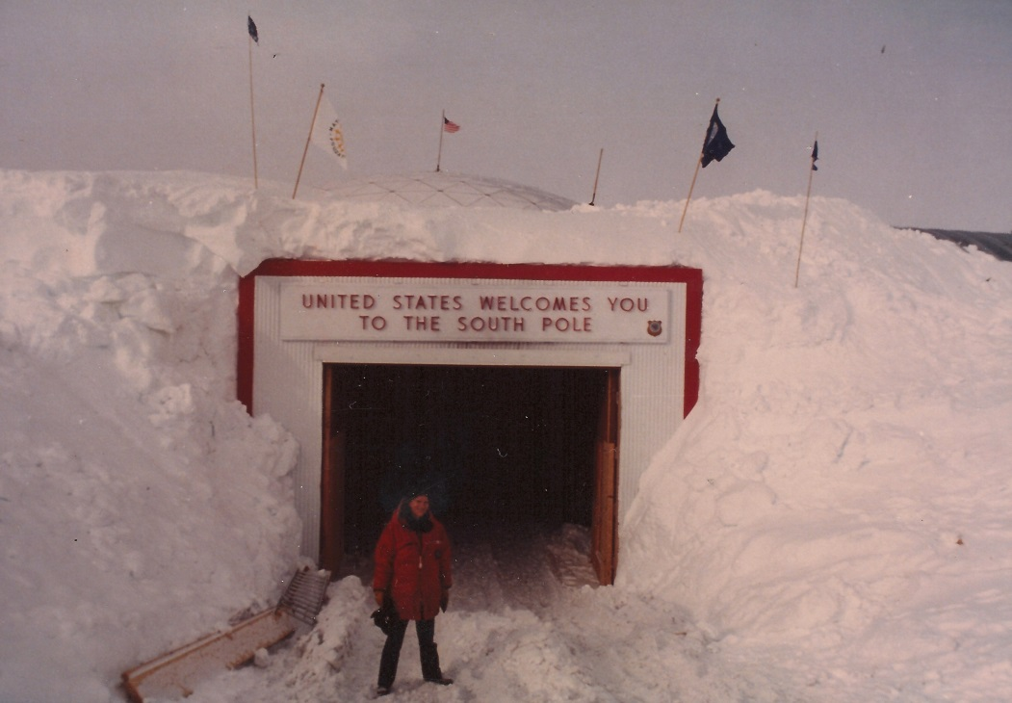

Slide 4
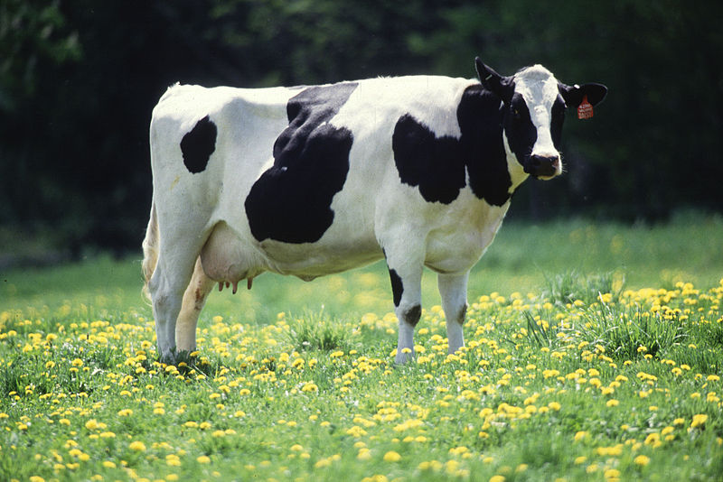
+ × / ≤ Ω ∑
∫ ∇ ⊃ ∞
cow
love, zest, hope?
Notes:
http://en.wikipedia.org/wiki/File:Cow_female_black_white.jpg

Slide 5
+
∑
/
×
⊃
∫
≤
Ω
∇
∞

Slide 6
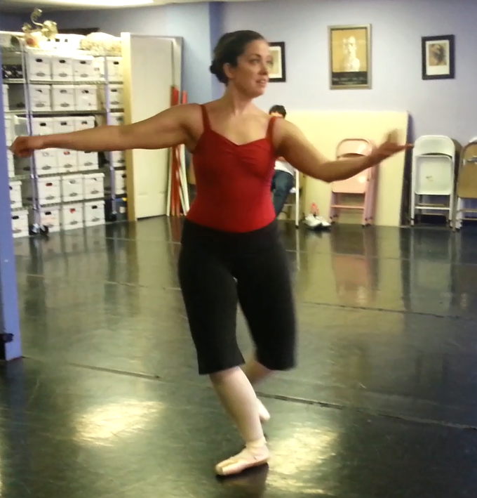
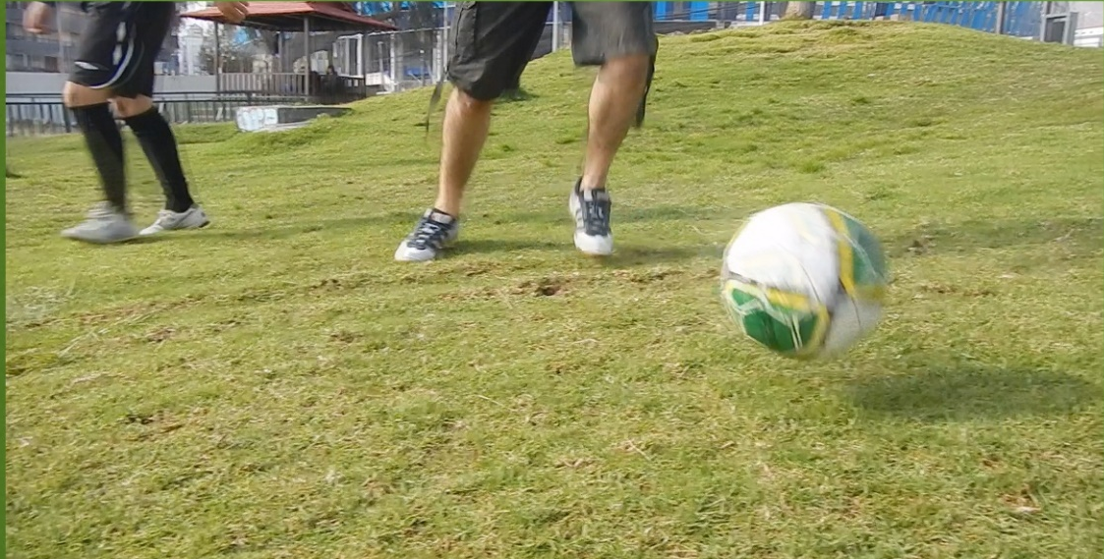

Slide 7
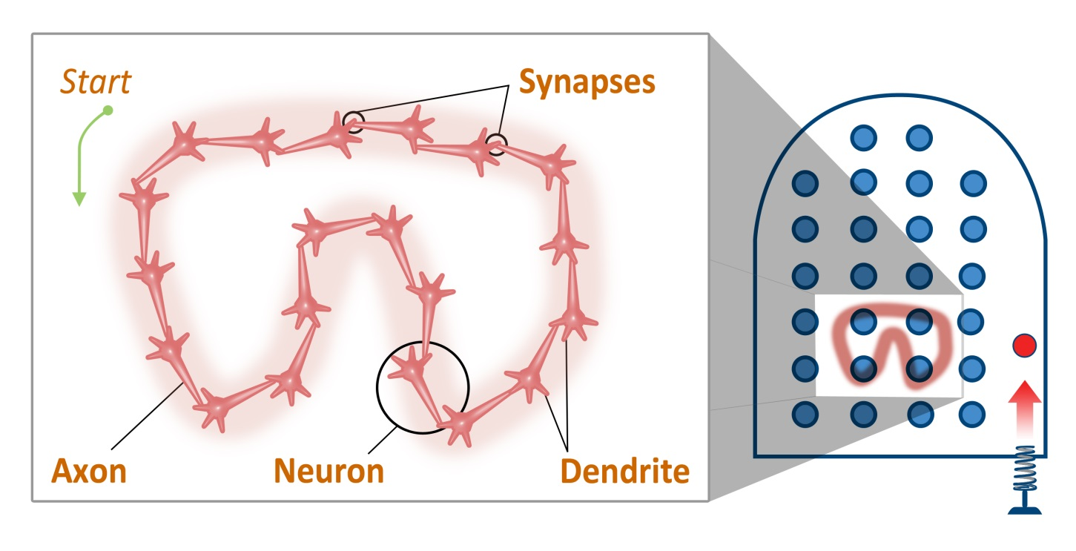
Creating a neural pattern

Slide 8
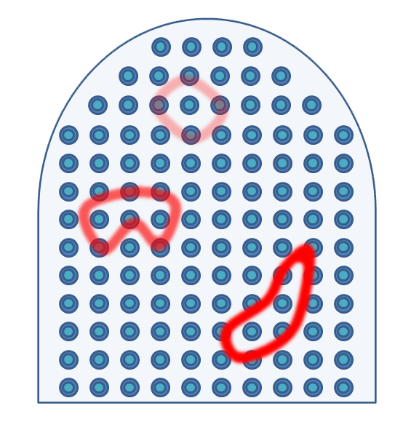
Practice makes permanent
Notes:
http://en.wikipedia.org/wiki/File:Cow_female_black_white.jpg

Slide 9
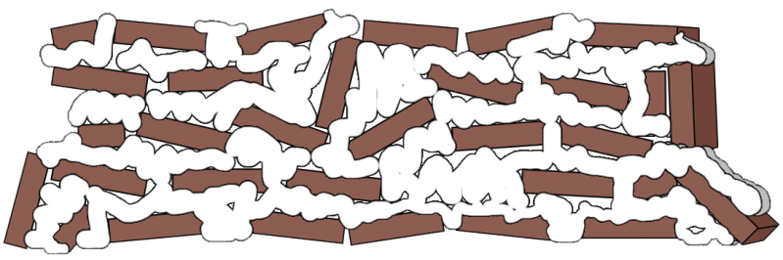
Building strong neural structures
A little every day
All at once

Slide 10
Relevant Readings
Brown, J.S., A. Collins, and P. Duguid. "Situated Cognition and the Culture of Learning." Educational Researcher 18, no. 1 (1989): 32-42.
Dunlosky, John, Katherine A Rawson, Elizabeth J Marsh, Mitchell J Nathan, and Daniel T Willingham. "Improving Students’ Learning with Effective Learning Techniques: Promising Directions from Cognitive and Educational Psychology." Psychological Science in the Public Interest 14, no. 1 (2013): 4-58.
Ericsson, Karl Anders. Development of Professional Expertise. NY: Cambridge University Press, 2009.
Geary, David C. The Origin of Mind. Washington, DC: American Psychological Association, 2005.
Geary, David C, A Wade Boykin, Susan Embretson, Valerie Reyna, Robert Siegler, Daniel B Berch, and J Graban. "Task Group Reports of the National Mathematics Advisory Panel; Chapter 4: Report of the Task Group on Learning Processes." In, (2008): 2008. http://www2.ed.gov/about/bdscomm/list/mathpanel/report/learning-processes.pdf.
Guida, A., F. Gobet, H. Tardieu, and S. Nicolas. "How Chunks, Long-Term Working Memory and Templates Offer a Cognitive Explanation for Neuroimaging Data on Expertise Acquisition: A Two-Stage Framework." Brain and Cognition 79, no. 3 (Aug 2012): 221-44.
Karpicke, Jeffrey D. "Retrieval-Based Learning Active Retrieval Promotes Meaningful Learning." Current Directions in Psychological Science 21, no. 3 (2012): 157-63.
Karpicke, Jeffrey D, and Phillip J Grimaldi. "Retrieval-Based Learning: A Perspective for Enhancing Meaningful Learning." Educational Psychology Review 24, no. 3 (2012): 401-18.
Karpicke, Jeffrey D, and Henry L Roediger. "The Critical Importance of Retrieval for Learning." Science 319, no. 5865 (2008): 966-68.
Karpicke, Jeffrey D, Andrew C Butler, and Henry L Roediger III. "Metacognitive Strategies in Student Learning: Do Students Practice Retrieval When They Study on Their Own?". Memory 17, no. 4 (2009): 471-79.

Slide 11
Relevant Readings (continued)
Karpicke, J. D., and J. R. Blunt. "Retrieval Practice Produces More Learning Than Elaborative Studying with Concept Mapping." Science 331, no. 6018 (Feb 11 2011): 772-5.
Karpicke, J.D., and J.R. Blunt. "Response to Comment on 'Retrieval Practice Produces More Learning Than Elaborative Studying with Concept Mapping'." Science 334, no. 6055 (2011): 453-53.
Kornell, Nate, Matthew Jensen Hays, and Robert A Bjork. "Unsuccessful Retrieval Attempts Enhance Subsequent Learning." Journal of Experimental Psychology: Learning, Memory, and Cognition 35, no. 4 (2009): 989.
Kornell, N., A. D. Castel, T. S. Eich, and R. A. Bjork. "Spacing as the Friend of Both Memory and Induction in Young and Older Adults." Psychology and Aging 25, no. 2 (Jun 2010): 498-503.
McDaniel, M. A., and A. A. Callender. "Cognition, Memory, and Education." In Cognitive Psychology of Memory, Vol 2 of Learning and Memory, edited by Henry L Roediger. 819-43. Oxford, UK: Elsevier, 2008.
Roediger, Henry L., and Mary A. Pyc. "Inexpensive Techniques to Improve Education: Applying Cognitive Psychology to Enhance Educational Practice." Journal of Applied Research in Memory and Cognition 1, no. 4 (2012): 242-48.
Roediger, Henry L, and Andrew C Butler. "The Critical Role of Retrieval Practice in Long-Term Retention." Trends in Cognitive Sciences 15, no. 1 (2011): 20-27.
Roediger, Henry L, and Jeffrey D Karpicke. "The Power of Testing Memory: Basic Research and Implications for Educational Practice." Perspectives on Psychological Science 1, no. 3 (2006): 181-210.
Rohrer, Doug, and Harold Pashler. "Increasing Retention without Increasing Study Time." Current Directions in Psychological Science 16, no. 4 (2007): 183-86.
Taylor, Kelli, and Doug Rohrer. "The Effects of Interleaved Practice." Applied Cognitive Psychology 24, no. 6 (2010): 837-48.
See also extensive endnote references and discussions in Chapters 2 and 3, A Mind for Numbers, Barbara Oakley, Penguin, 2014.

Slide 12
Image credits
Barbara Oakley, age 10, with Earl the lamb.
Barbara Oakley, age 18, in the US Army.
Barbara Oakley, on the Soviet trawler “Tigil” on the Bering Sea, 1983.
Barbara Oakley at South Pole Station in Antarctica, 1983.
Philip Oakley, Siple Station, Antarctica, 1982.
http://en.wikipedia.org/wiki/File:Cow_female_black_white.jpg
Dance footage courtesy Jaclyn Raley, ©Jaclyn Raley, 2014.
Soccer footage courtesy Kevin Mendez, ©Kevin Mendez, 2014.
Creating a neural pattern, ©Kevin Mendez, 2014.
Practice makes permanent, ©Kevin Mendez, 2014.
Building strong neural structures, ©Kevin Mendez, 2014.
Clip art courtesy Microsoft Corporation.

